Slide 1
BOOK CLOUD
MINAL pATEL

Slide 2
Overview
What is Book Cloud?
Wireframes and User Stories
SQL, Springboot
JavaScript ,HTML and CSS
Functionality
Testing
What would I do in the next Iteration?

Slide 3
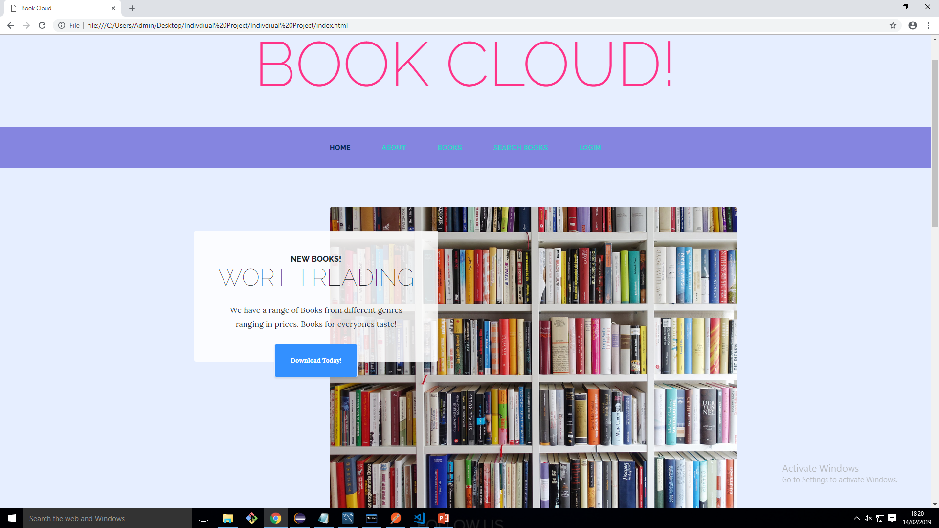
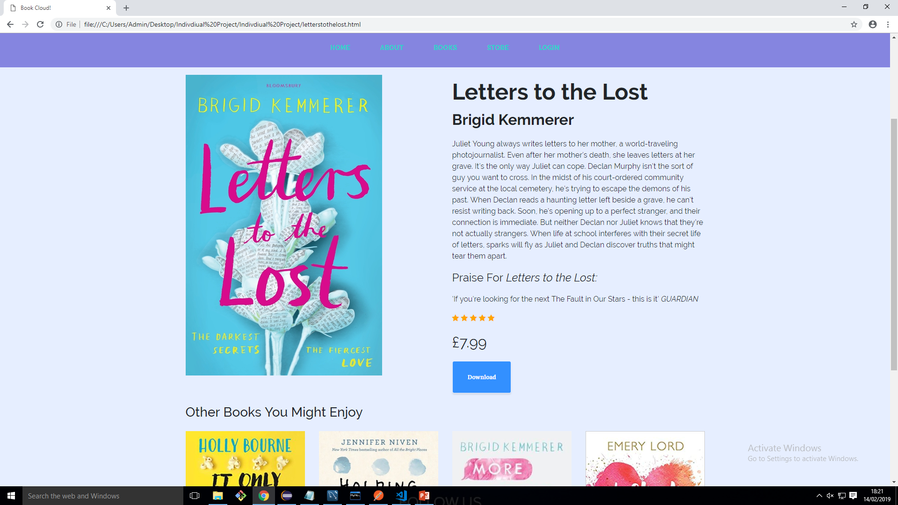
The Idea

Slide 4
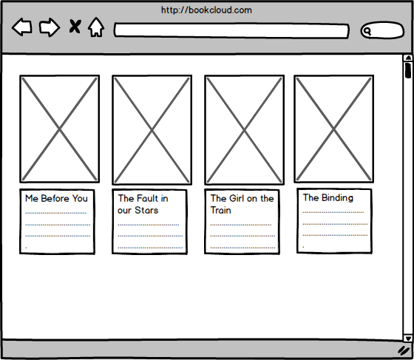
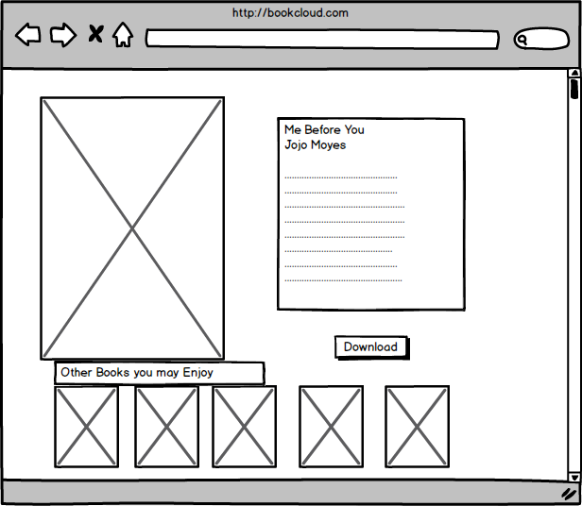
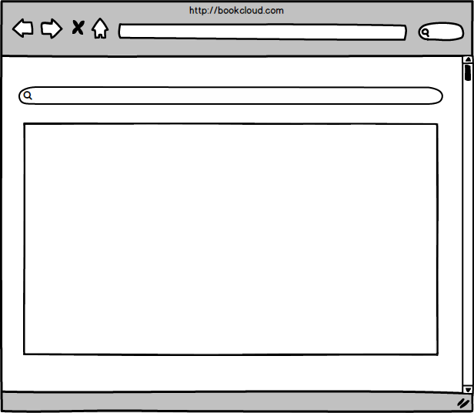
Wireframes

Slide 5
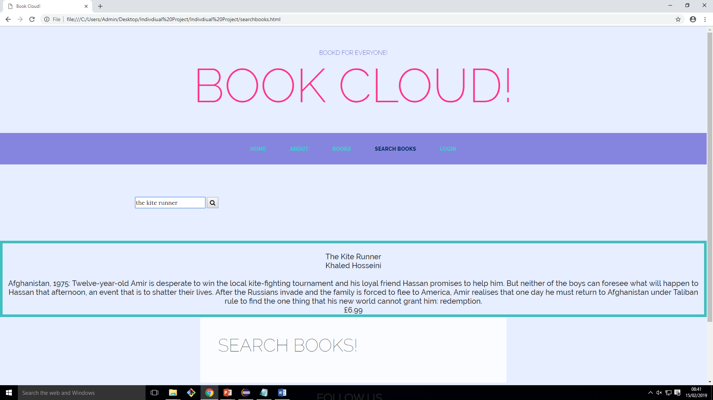
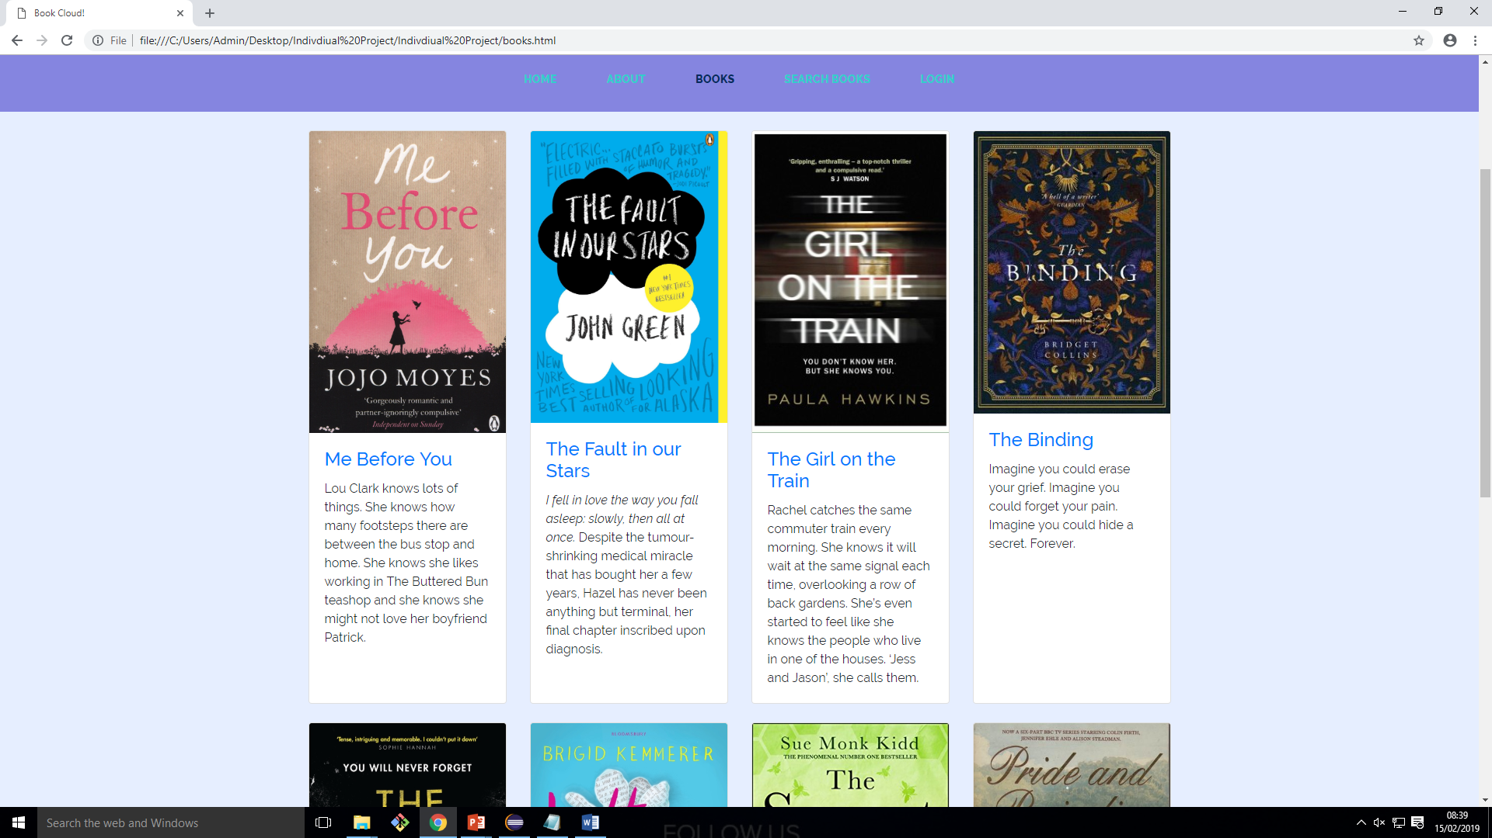
User Stories
Given that I am searching for a book on a website, when I navigate to the books page, I can browse books on the website, so that I can find the book I want.
Given that I am searching for a book on a website, when I navigate to the Search books page, I can search for a specific book on the website, so that I can find the book I was searching for.

Slide 6


SQL AND SPRINGBOOT
SQL was used at the very beginning stage of my project to implement the database.
Springboot was used to implement a Model, Controller and a repository to connect the database. – CRUD functionality. The database was connected to via a JDBC Connection.

Slide 7
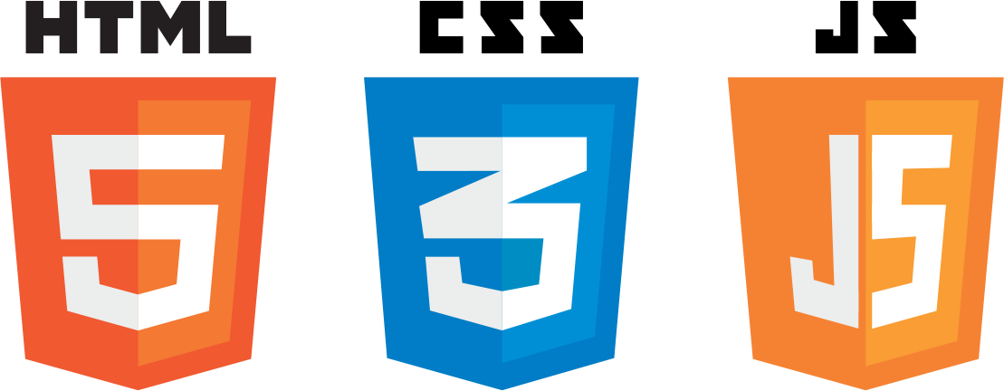
HTML,CSS AND JAVA SCRIPT
JS was used to connect the backend to the frontend to allow functionality.
CSS was used for the design (fonts, layout) and Colour Scheme for the Project.
HTML and Bootstrap was used to implement the front end.

Slide 8
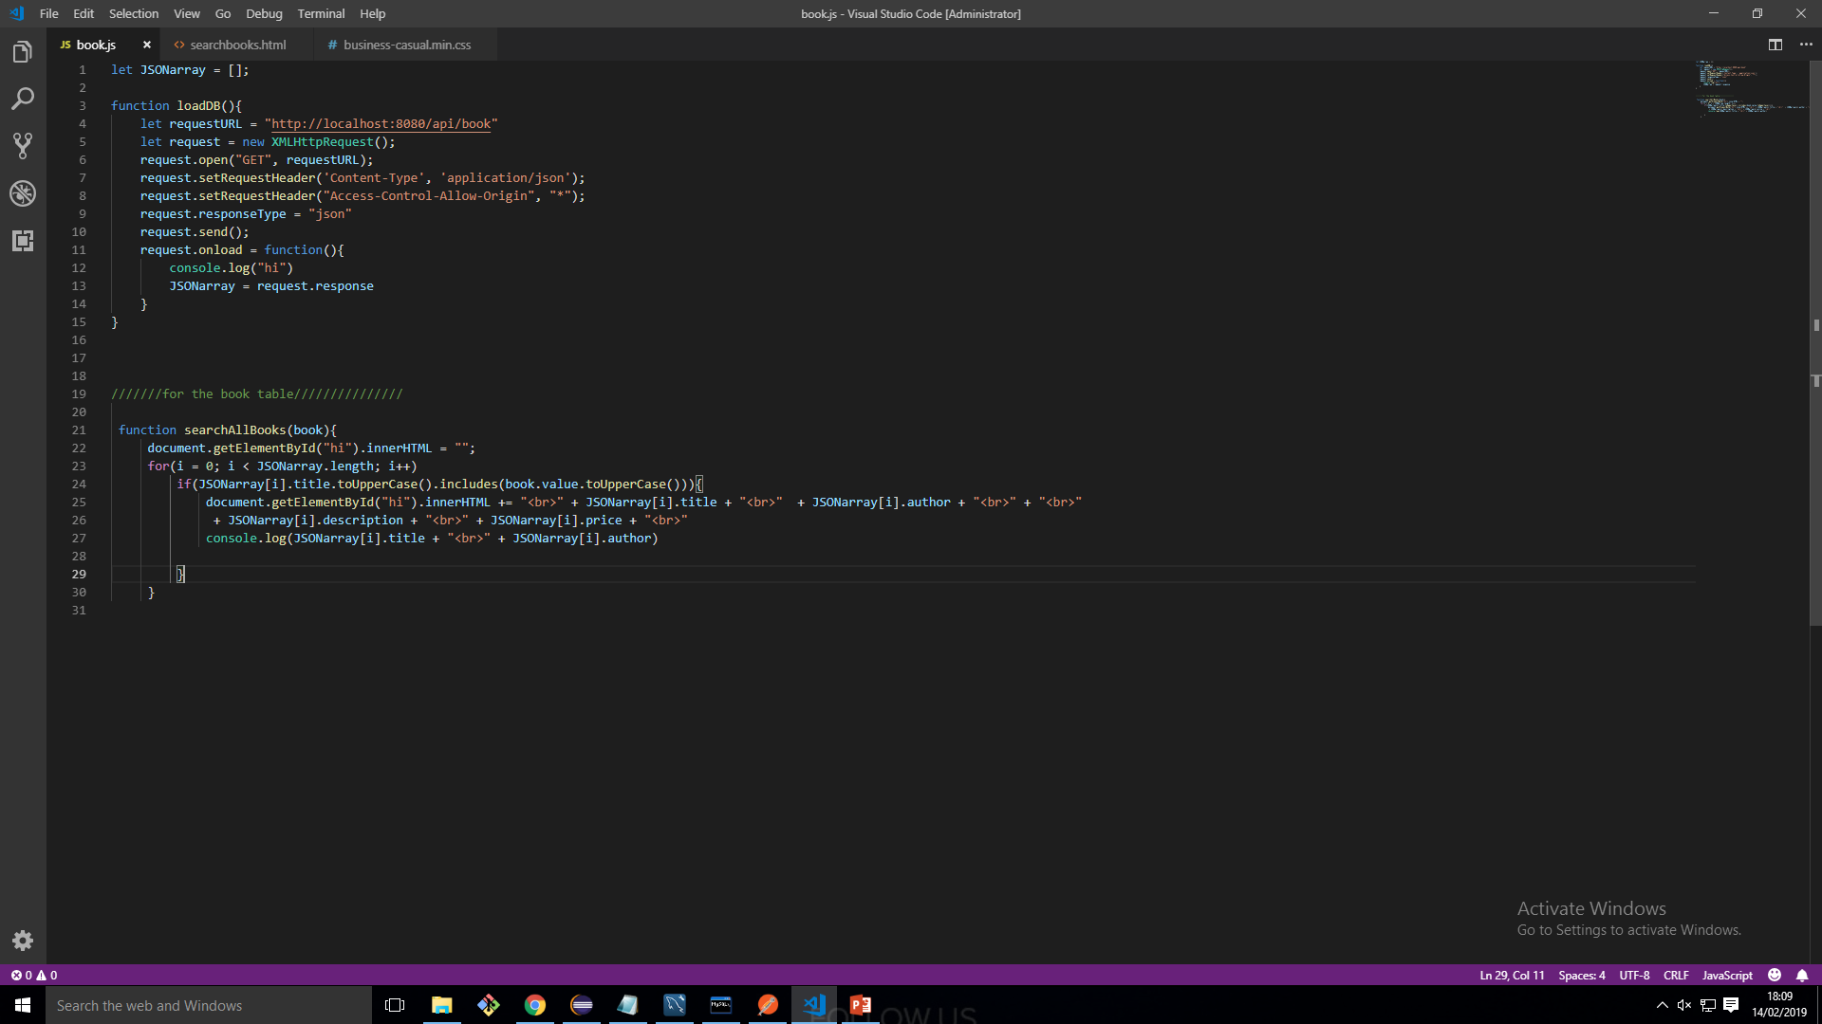
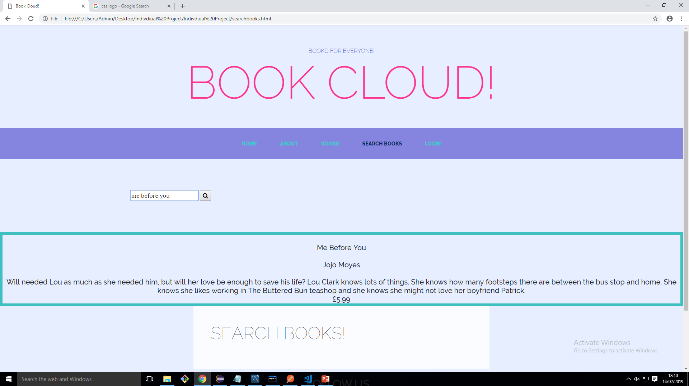
Functionality
This allows the user to search for books that are within the database. The database was loaded using an onload function.

Slide 9
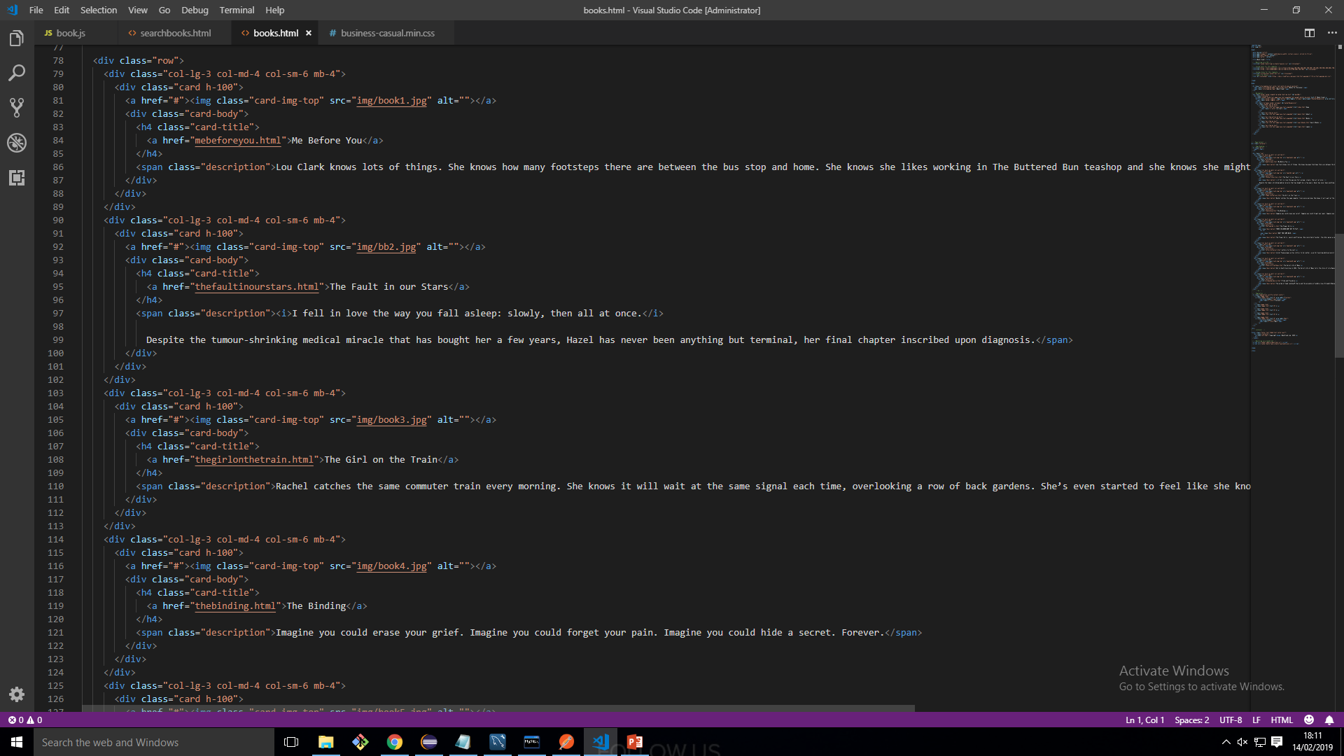
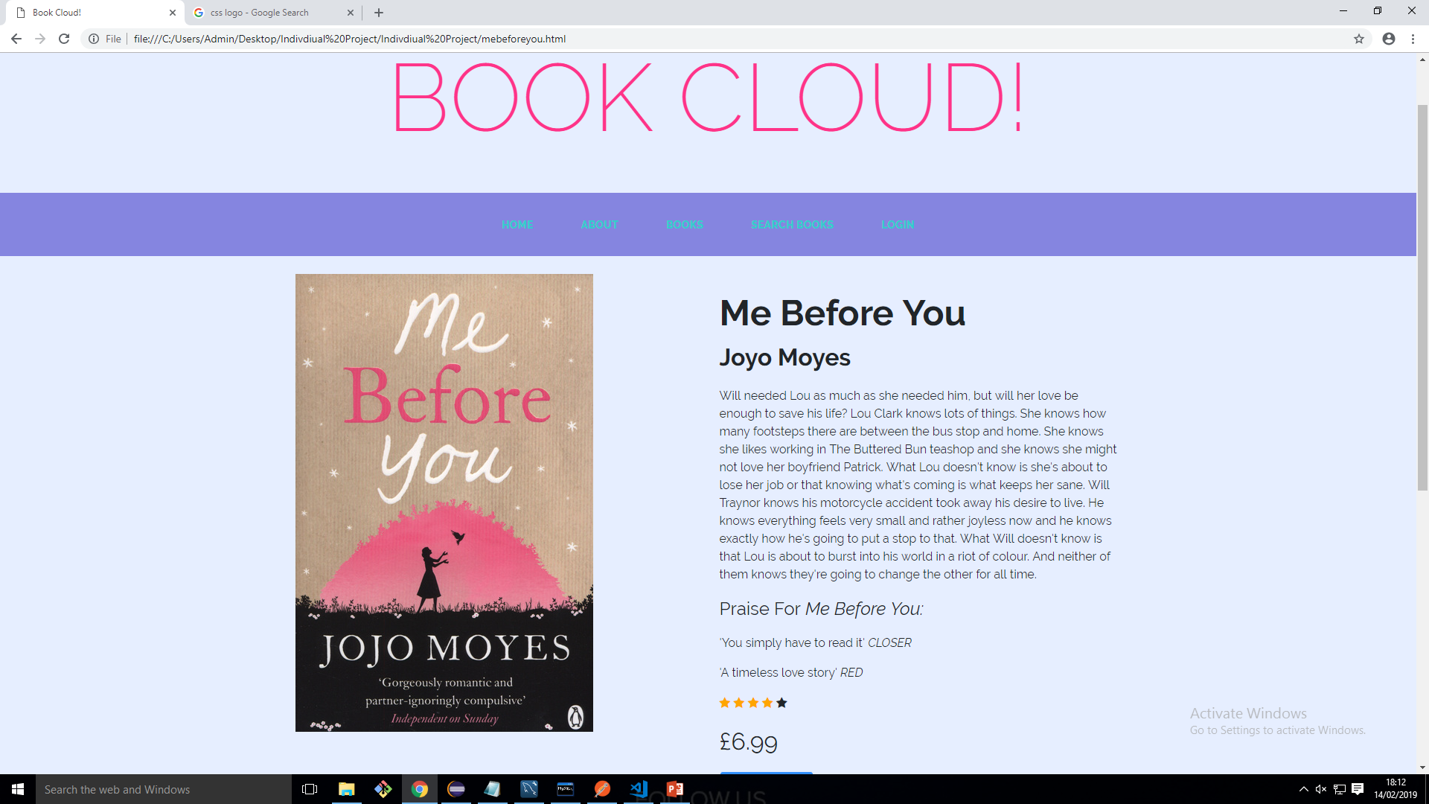
Functionality
This allows the user to browse books and then select the title and it will navigate to a new page and the user will be able to see more information about the book including reviews , price and ratings.

Slide 10
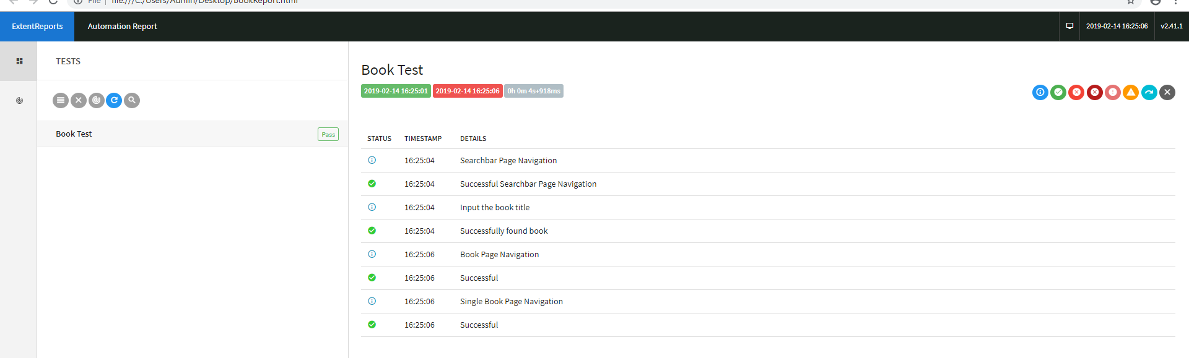
Testing
Repository Testing – Done through JUnit – Test to search through the database and retrieve data by ID
Integration testing – Tests the Mapping Methods – GET , PUT , POST and DELETE - CRUD functionality.
Selenium and Cucumber – BDD –Testing to ensure the website is functional.

Slide 11
What would I do in the next Iteration?
Add a login functionality – This would allow a user to login and view which books they have downloaded.
Add a checkout functionality – User would be able to go through a checkout process
Implement more tests into the project

Slide 12
Thank you for Listening
Any Questions?

